Slide 1
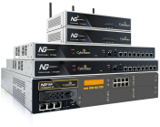
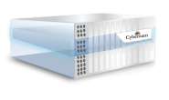
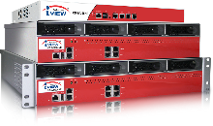
http://firewall.firm.in
Cyberoam Next-Generation Security
Presenter: IT Monteur
Our Products
Network Security Appliances - UTM, NGFW
(Hardware & Virtual)
Modem Router
Integrated Security appliance

Slide 2
Cyberoam Introduction
Technology Powerhouse
550+ Employees
Sales, Distribution Channel and Customers across 125+ Countries
Amongst the top 3 global players for network security features
Patent-pending Identity-based Management

Slide 3
Cyberoam Product Line
Physical
Virtual
Cloud
Network Security
Cyberoam
Next-Gen Firewall/ Unified Threat Management
Cyberoam virtual
Next-Gen Firewall/ Unified Threat Management
Cyberoam Security on Amazon Cloud (currently in Beta)
SOHO, HOME
Centralized security Management
Cyberoam Central Console
Cyberoam Central Console
Network Monitoring & Analysis
Cyberoam iView software
Cyberoam iView

Slide 4
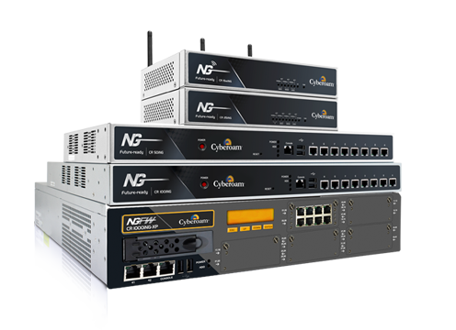
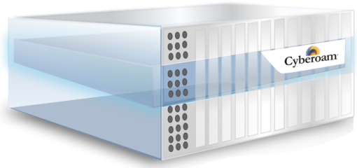
Network Security Appliances – UTM, NGFW
(Hardware & Virtual)

Slide 5
Cyberoam Next-Generation Security
UTM Features
Core NGFW Features
Layer-8 Security
Firewall
Application Filtering
IPS
VPN
Web & Content Filtering
Bandwidth Management/QoS
On-appliance reporting
IPv6 Support
Multi-link Management
Gateway Anti-Virus
Gateway Anti-Spam (Inbound/outbound)
Web Application Firewall
Wireless Security
Support for 3G/4G/WiMAX

Slide 6
Cyberoam Architecture
Powerful Hardware
Multicore Gigahertz processors for Nano second security processing
Gigabit Ports to integrate with Gigabit network
Intelligent Firmware
Tight integration with Hardware
Network & Crypto Acceleration

Slide 7
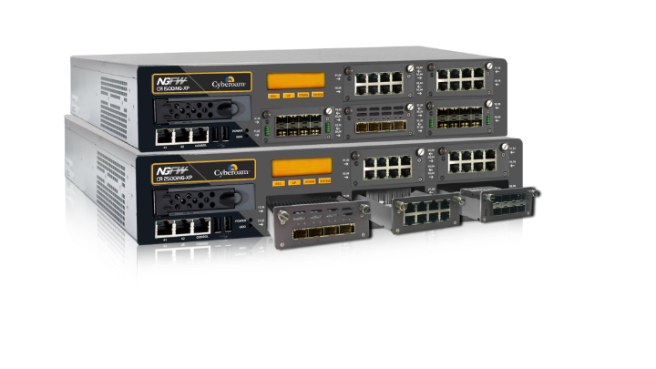
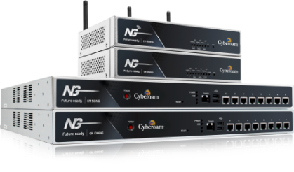
High Performance Security Appliances
Top model CR2500iNG-XP offers
Firewall Throughput: 160 Gbps
NGFW Throughput: 10 Gbps
Bringing Gigabit Firewall throughputs within the reach of small offices and branch offices

Slide 8
Cyberoam Innovation: Layer 8 Security
Cyberoam's Layer 8 Technology treats “User Identity” as the
8th Layer in the protocol stack
Cyberoam network security appliances offer security across Layer 2-Layer 8 using Identity-based policies

Slide 9
AAA over single Cyberoam appliance
Identity-based AAA
Users
Cyberoam Authenticates
Cyberoam Authorizes
Cyberoam Audits
Employees
Management
User Name
IP Address
MAC Id
Session Id
Internet surfing quota
Schedule control
Security Policies
Web Filtering
Application Visibility & Control
QoS / Bandwidth Management
IM Controls
Identity–based Logs + Reports
Compliance Reports
Customers
Partners
Control user network activities
Who can connect to the network
Who can access what
What have they accessed
Ability to track the user activities; identify attackers /victims
Take quick network security decisions

Slide 10
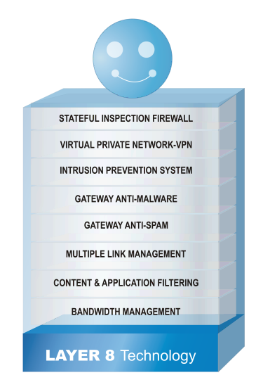
Identity-based Security
192.168.3.110
Ancy Logged out
Corporate LAN
DHCP
192.168.3.110
Ancy
192.168.3.105
Richard
192.168.3.110
192.168.3.110
Steve
192.168.3.110
192.168.3.105
Internet
Applies security policies based on actual identity of users.
User-specific rules for multiple users to share a common IP address
Administrator

Slide 11
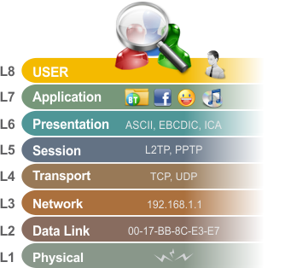
Application of Layer 8 Technology
Two Factor
Authentication
Port-based
Authentication
(802.1x)
BYOD Clients
- iOS, Android
Authentication
API
VPN
Thin Client
NTLM
Layer 8 security

Slide 12
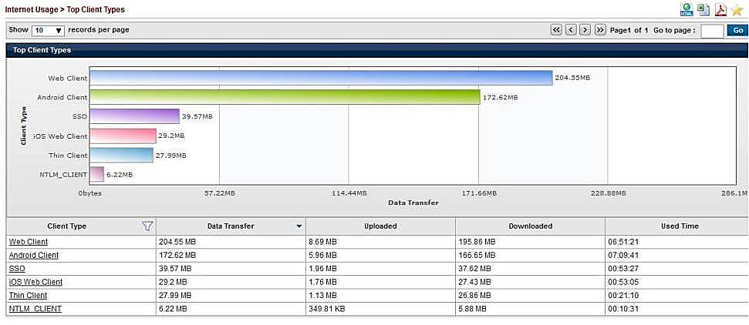
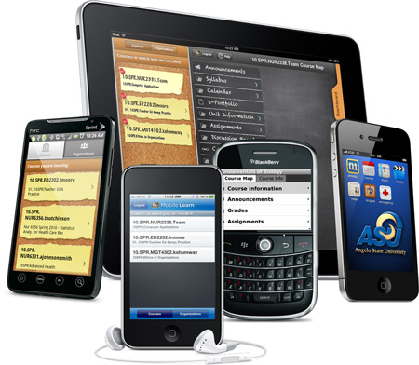
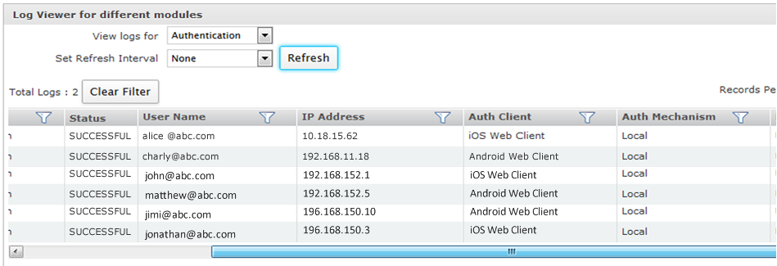
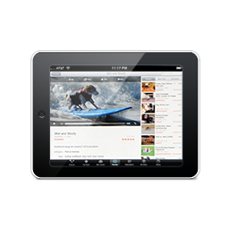
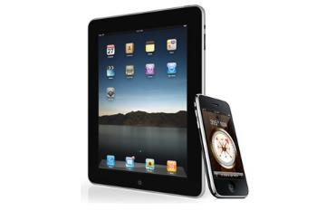
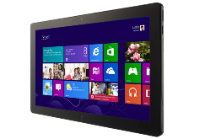
Providing insights into BYOD buildup
Device usage visibility
Identify & flag BYOD users
Enhancing BYOD experience with Clients

Slide 13
Application Visibility & Control
Industry leading coverage for Visibility & Control over 2200+ key applications

Slide 14
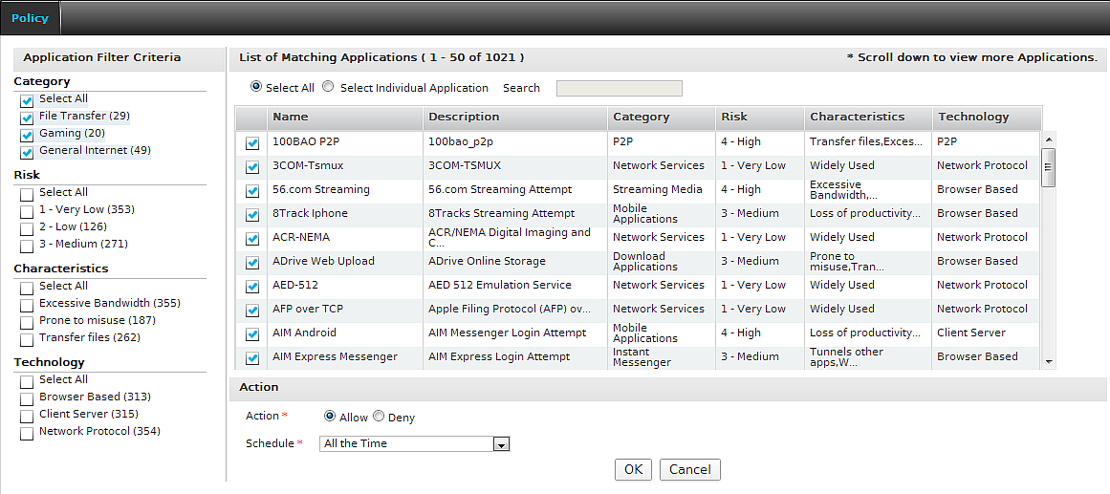
Simple yet Powerful Granular Application Controls
Eliminates the need for manual intervention by administrators to update policies for new applications added to the list
Category
File Transfer
Gaming
General Internet
Instant Messenger
Infrastructure
Network Services
P2P
Proxy and Tunnel
Remote Access
Streaming Media
VoIP
Mobile Applications
Social Networking
Web Mail
And more…
Risk Level
Very Low (1)
Low (2)
Medium (3)
High (4)
Very High (5)
Characteristics
Excessive Bandwidth
Prone to misuse
Transfer files
Tunnel other apps
Widely used
Loss of Productivity
Can bypass firewall policy
Technology
Browser Based
Client Server
Network Protocol
P2P
Control over combination of
Application or
Application Category
User or
User Group
Bandwidth
Time
In-House Security Capabilities
Faster turnaround time
e.g Adding application signatures for new applications and dynamic apps designed to work around network like UltraSurf.

Slide 15
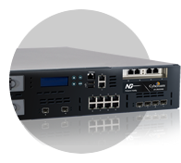
Web & Content Filtering
Industry’s most comprehensive URL database
100 million+ URLs in 89+ categories
Control over combination of
Controls access to HTTP/HTTPS websites
Blocks Google Cache pages
Blocks Embedded URLs
Blocks Malware hosting sites
User or
User Group
Bandwidth
Time
Detects & Blocks Third Party Proxy and Tunneling sites
Website category
Filters Web 2.0 content
Proxy
& Tunneling sites
Proxy
& Tunneling sites
Allowed
Websites
HTTP/
HTTPS
Malware hosting sites
Google cache pages
Google cache pages
Malware hosting sites
Blocked
Websites
HTTP /HTTPS
Embedded URLs
Embedded
URLs
Web
2.0
Website
HTTP /
HTTPS
Web 2.0
Internet
Web 2.0

Slide 16
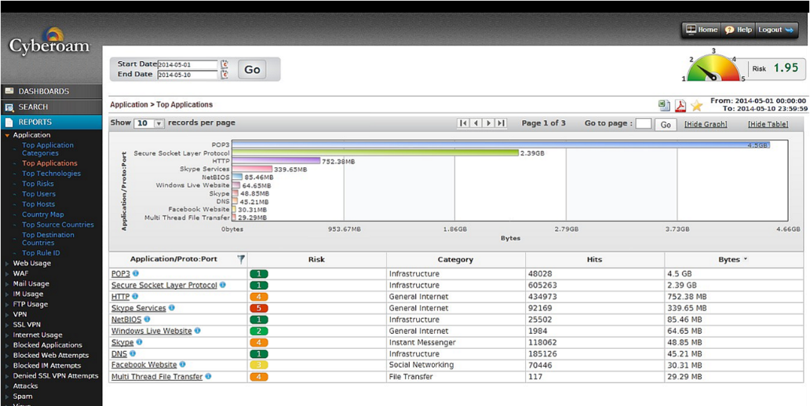
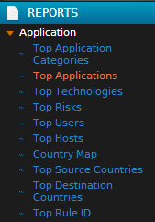
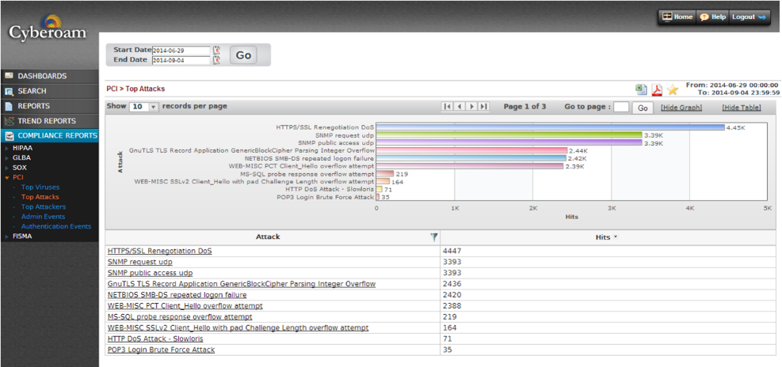
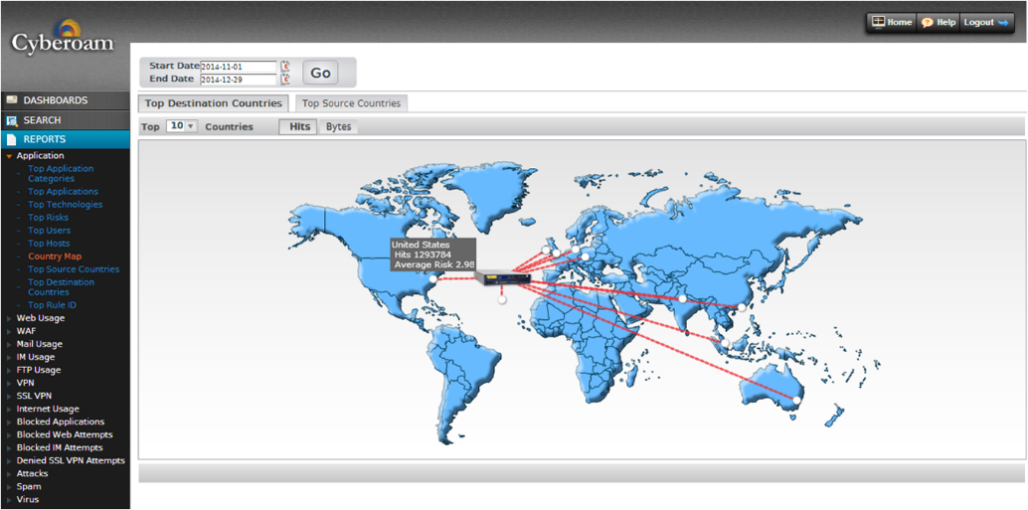
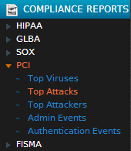
Best-in-class on-appliance Reporting
1200+ reports
Real time visibility into user and network activities
Helps with Security & Compliance Management, Forensic Analysis
Traffic Discovery
Real-time visibility into bandwidth utilization by user, protocol, application
Application Reports
Compliance Reports
Interactive World Traffic Map

Slide 17
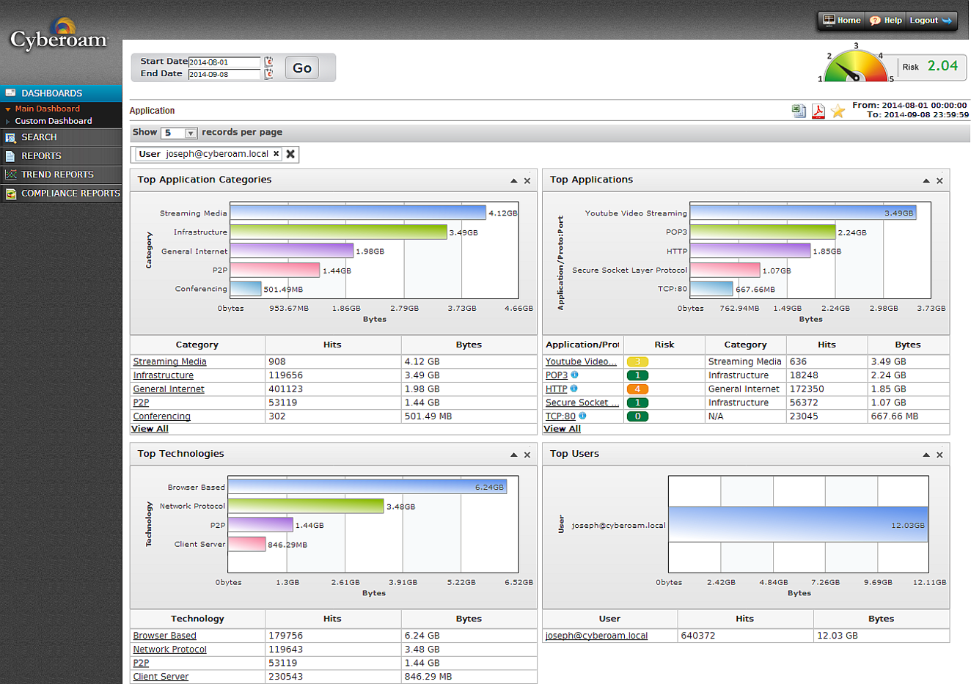
Layer-8 User-based Reports

Slide 18
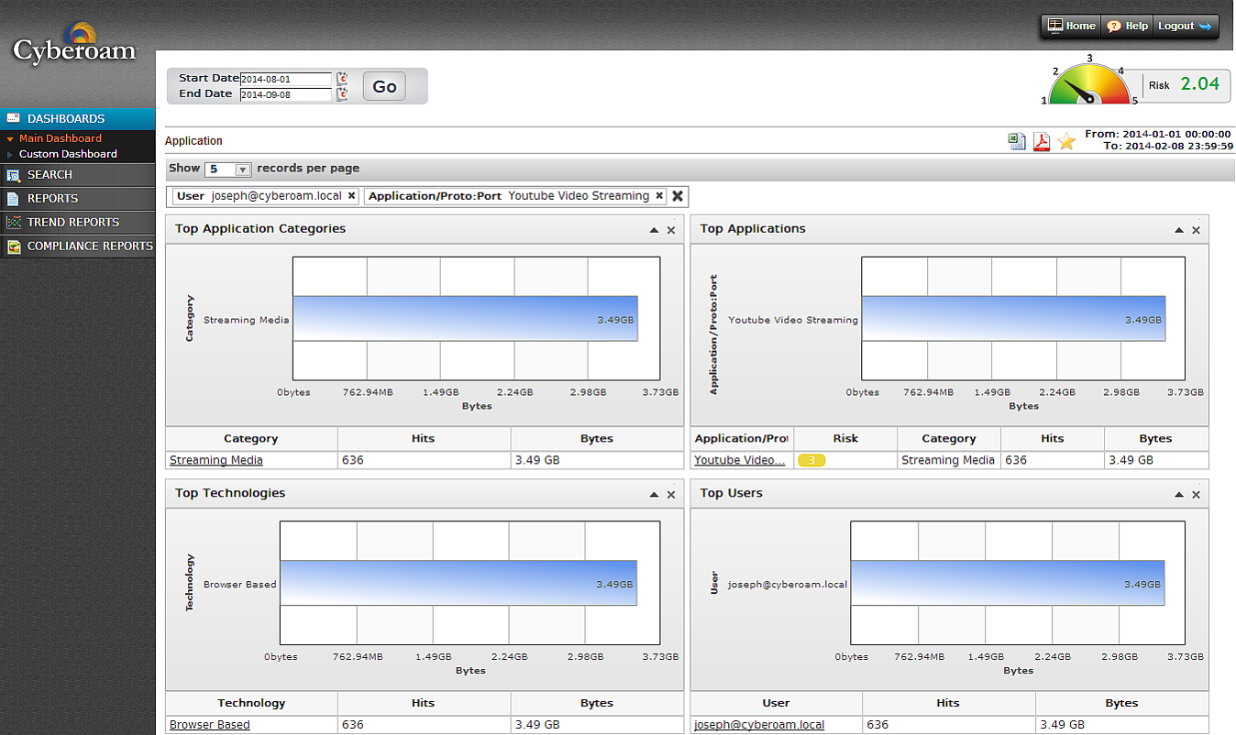
Layer-8 User-based Reports

Slide 19
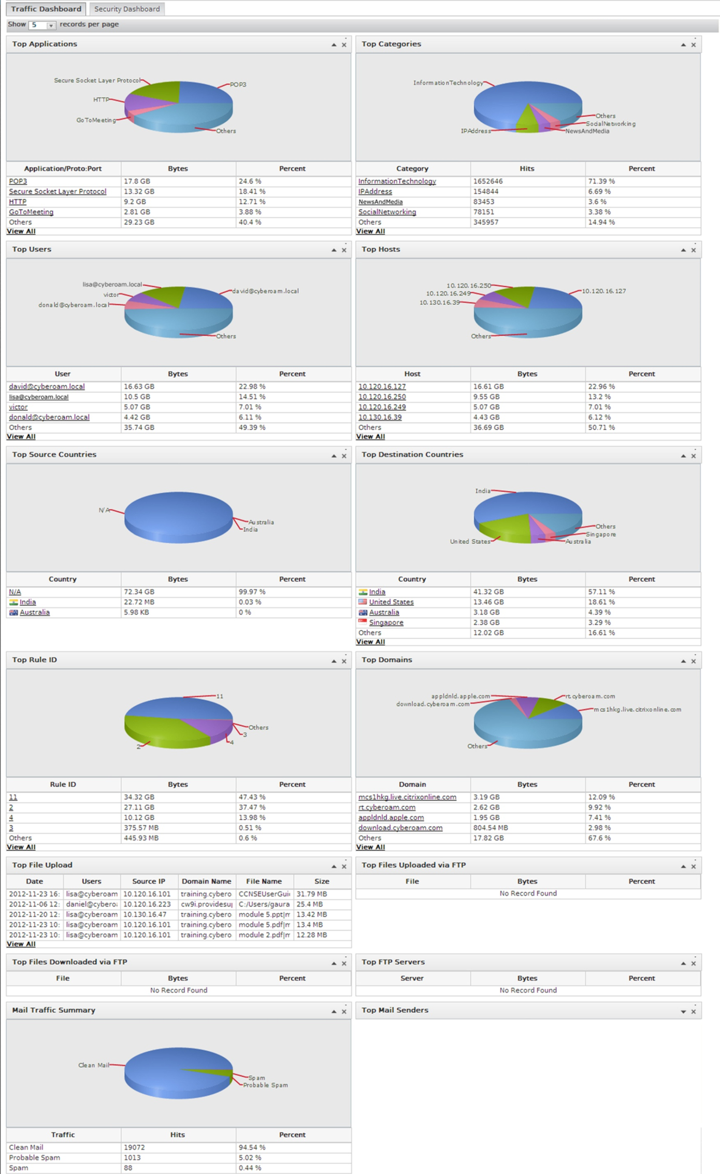
Dual Dashboard – Traffic & Security Dashboard
Traffic Dashboard

Slide 20
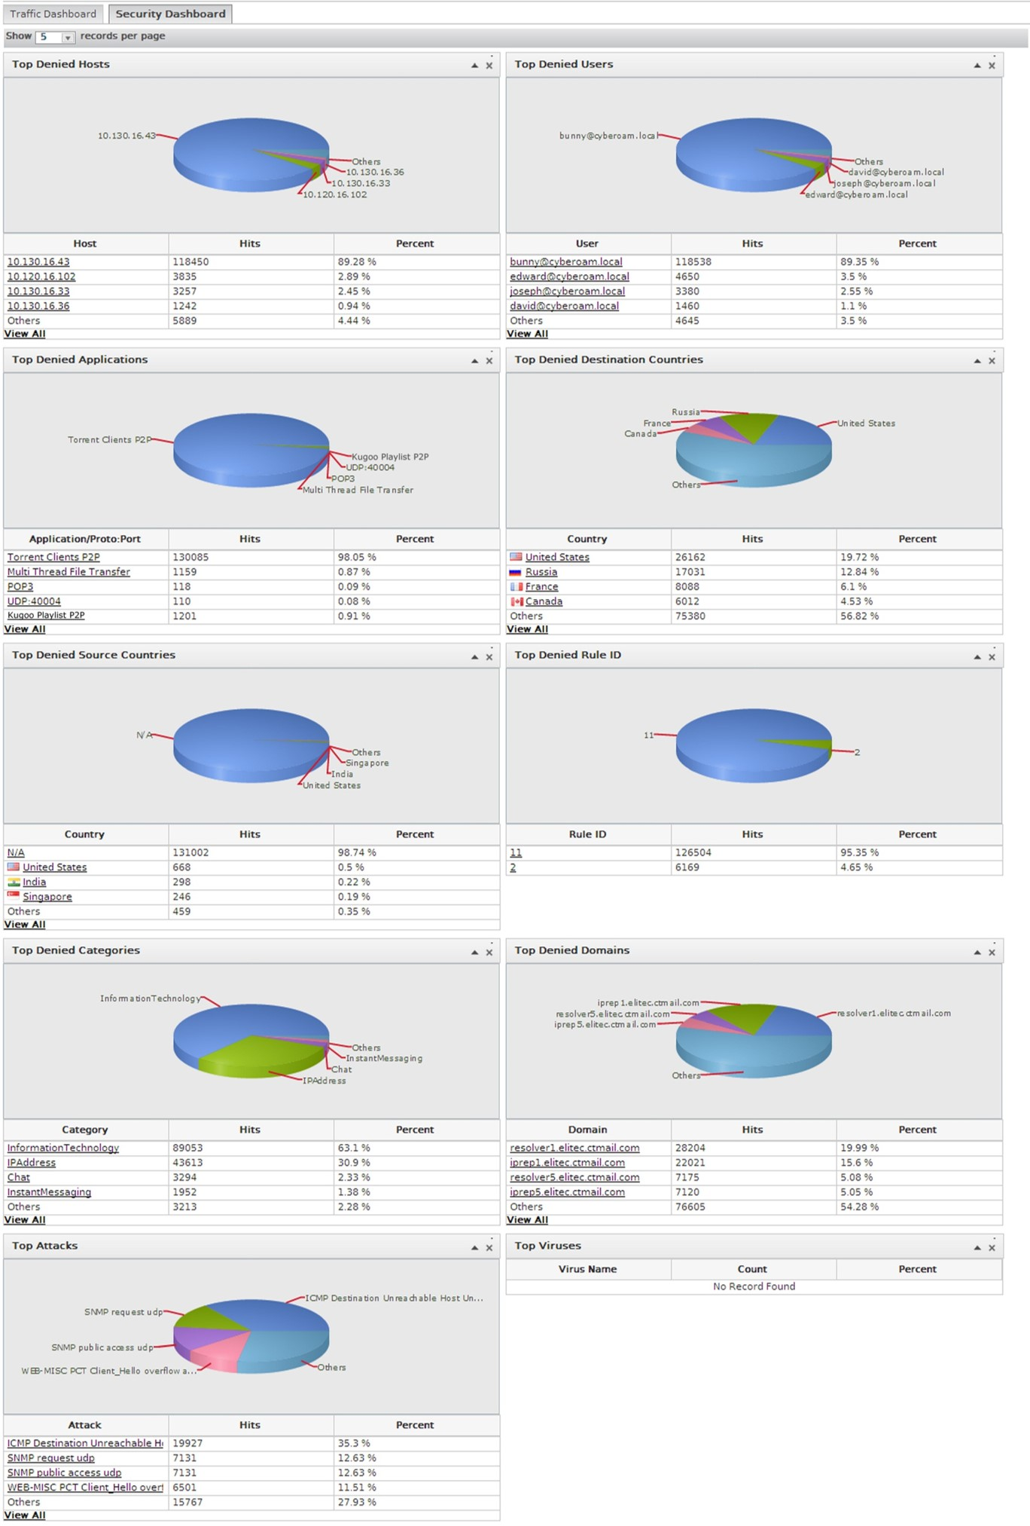
Dual Dashboard – Traffic & Security Dashboard
Traffic Dashboard

Slide 21
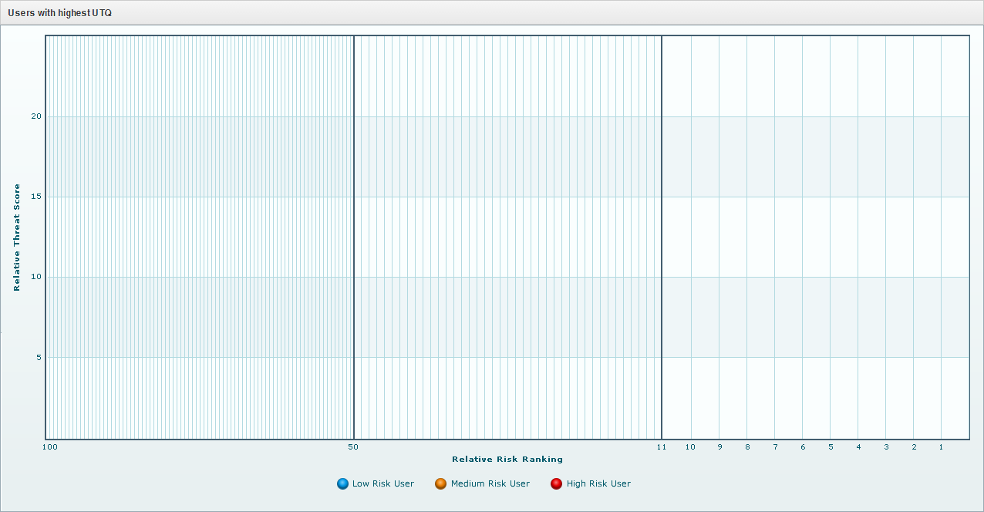
User Threat Quotient (UTQ) Report: Spot risky users at a glance
User: jenny.lewis
Relative Threat Score: 20.1
Relative Risk Ranking: 1

Slide 22
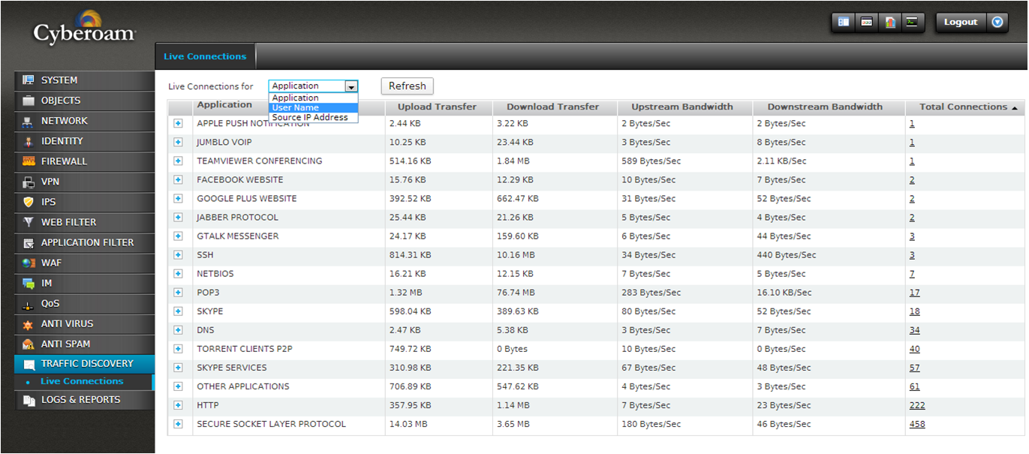
Traffic Discovery

Slide 23
Stateful Inspection Firewall
Unified Security
Application Firewall
Identity-based Firewall
Layer 8 Geo-based Traffic Control
Control incoming/outgoing traffic from/to a specific country
FastPath Technology
To improve processing speed and reduce CPU overhead
Security Policies
Firewall Rule
Connectivity Policies
Productivity Policies
Unified Security
Rules for all security features from firewall page
Easy navigation and increased administrative productivity

Slide 24
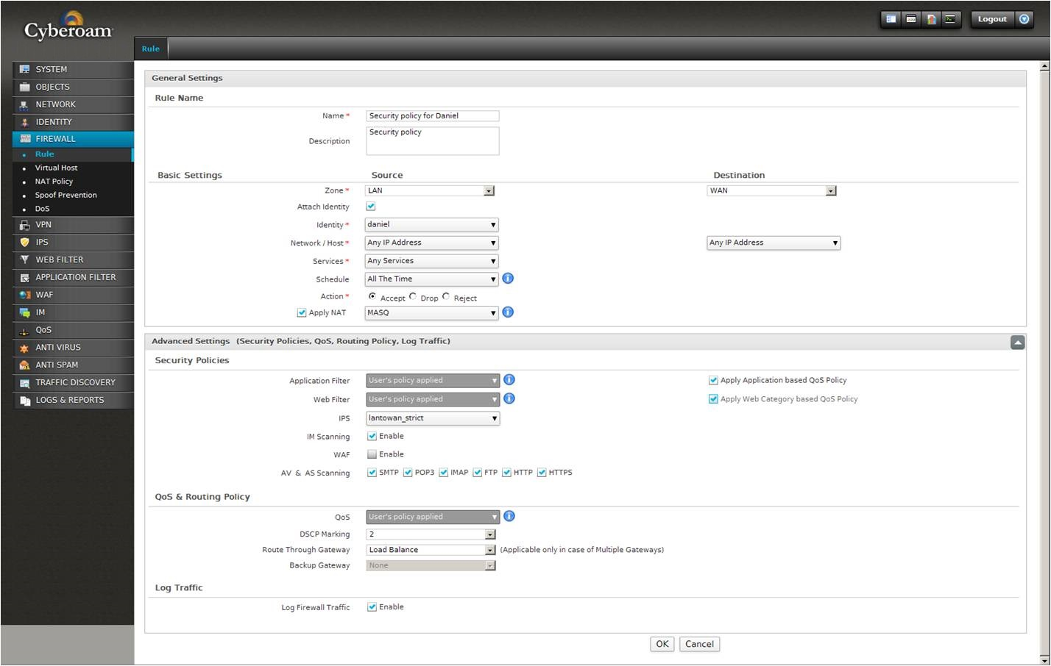
Configure rules for all features from Firewall page
Identity
+
Security
+
Productivity
+
Connectivity

Slide 25
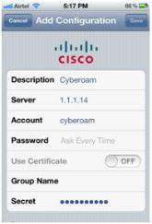
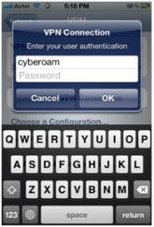
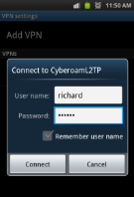
Virtual Private Network (VPN)
Embrace BYOD with mobile VPN clients
Support for IPSec, L2TP, PPTP, SSL VPN
Threat Free Tunneling (TFT) Technology
Supported VPN Clients
MacOS
iOS
Android Devices
Scans VPN traffic for Malware, Spam, Inappropriate content, Intrusion attempts
Advanced features for business continuity
MPLS failover to VPN
VPN failover
iOS
IPSec VPN
L2TP VPN
PPTP VPN
SSL VPN
Client-based & Client less
License free
Android
L2TP VPN

Slide 26
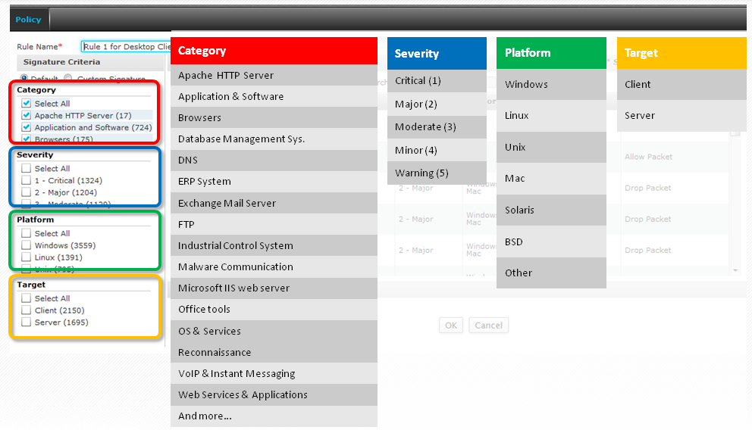
Intrusion Prevention System (IPS)
Many SOHO/SMBs struggle with IPS
What to allow or deny?
Which IPS policy applies?
Ready to use IPS Policy templates with Firewall Rule style naming convention
Customizable security for Enterprise IT Pros

Slide 27
Threat Protection Features
Intrusion Prevention System
Layer 8 and IPS Tuner driven
Identity-based IPS policies per user, group and IP address
Allows multiple IPS policies
Identity-based alerts & reports
4500+ signatures – broadest security cover
Gateway Anti-Virus, Anti- spyware
Bi-directional scanning: Web & Email
Self-service Virus Quarantine
Scans HTTP, FTP, SMTP, POP3, HTTPS, IMAP and IM traffic
Instant visibility into Attacker/Victim
Cyberoam Security Center
Anti-Spam (Inbound/Outbound)
Three level scanning:
IP Reputation filtering
Real-time Blackhole List (RBL)
Recurrent Pattern Detection (RPDTM) technology
~99% spam detection
Self-service Quarantine and Spam Digest
Scans SMTP, POP3, IMAP traffic
Virus outbreak detection for zero-hour protection
DoS & DDoS Protection
Packet Rate Limit
Protection against flood attacks
SYN Flood
TCP Flood
UDP Flood
ICMP Flood
IPS Signature to prevent attacks
Protocol Anomaly
Continuously updated via
Cyberoam Security Center

Slide 28
Best of Breed Bandwidth Management / QoS
Create a bandwidth policy on a combination of
User or User Group /Department
Application or Application Category
Web category
Allows great flexibility and real L2-L8 visibility and control
Bandwidth sharing with priority
Schedule-based bandwidth allocation
Committed bandwidth
Allocate dedicated bandwidth
Burstable bandwidth
Share the unutilized bandwidth
Marketing Group
6mbps
When user is not connected
CEO
Manager
ERP System
5 mbps
2 mbps
8 mbps
Manager
2mbps
Employee 1
3mbps
Employee 1
2mbps
Employee 2
2mbps
Employee 2
3mbps

Slide 29
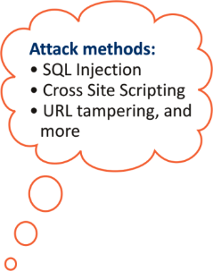
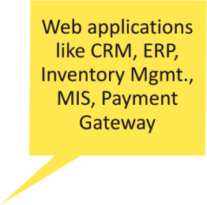
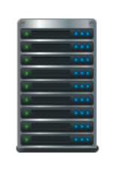
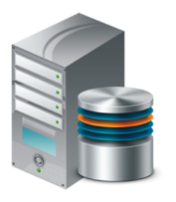
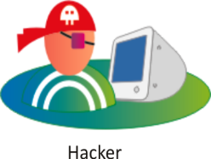
On-appliance Web Application Firewall (WAF)
Firewalls/IPS cannot protect a web application from unknown threats
Cyberoam’s on-appliance WAF
Protects web-apps and web servers from hackers
Positive protection model and No Signature Tables
Intuitive website flow detector Automatically adapts to website changes
Protects against OWASP top 10 web-app vulnerabilities
SSL Offloading
Monitoring & Reporting
Web &
Application
Server
Traditional
Firewall
Database
Server
Cyberoam’s on-appliance WAF protection
Organization's IT network
Unauthorized access blocked
Cost Effective
No need to buy dedicated hardware WAF
Easy to deploy
Does not require any changes in setup

Slide 30
Business Continuity Features
High Availability
Active-Active & Active-Passive
Reduces single-point-of-failure
Maximizes network uptime and ensures continuous network security
Multiple Link Management with Automated Load Balancing
Multiple WAN and WWAN (3G/4G, WiMax) link management with multiple failover conditions
Active-Active and Active-Passive Auto Link Failover
Gateway failover over VPN
Layer 8 Policy-based Routing
Routes traffic based on Source IP addresses, Protocols & Users
Assures QoS for key users and applications
Sales Dept.
MPLS
ISP1
(10 mbps)
Dev. Dept.
ISP2
(5 mbps)
ISP3 (3G)
(3 mbps)
_{Failover Link}
Finance Dept.
Organization's IT network

Slide 31
Cyberoam API
User Authentication API for Hotspots
Re-use Hotspot Authentication; avoid multiple logins
Seamless Single Sign-on for Enterprises
3rd Party authentication solutions can be integrated with Cyberoam
Manage Cyberoam with 3rd party policy management systems

Slide 32
Safeguard user privacy – 4-Eye Authentication
Prevent the risk of IT administrator from misusing privilege of tracking user activities
2 people: Authorizer and Administrator
Authorizer consent required for the Administrator to view user-specific activities

Slide 33
FleXi Ports for flexible network connectivity
Fixed Copper GbE Ports
Combination of Fixed Ports and Flexible Ports
Flexibility to choose Copper, Fiber 1GbE / 10GbE modules
Modules can be purchased individually as per need

Slide 34
Cyberoam features assure Security, Connectivity, Productivity
Organizations cannot afford to compromise on any of these.
The right SCP balance is essential!

Slide 35
Customer Support System
Web
Support
Support available across all time zones
Global Support Excellence - ITIL compliance (ISO 20000)
Chat
Support
Appliance Registration and Upgrade
Subscribe security features
Create support tickets
Request RMA
Email
Support
Phone
Support
Knowledge
base

Slide 36
Partner Support System
Web
Support
Region specific dedicated Technical Account Managers (TAM)
Chat
Support
Ordering & Inventory management
Sales & Marketing tools & resources
Presales Support
Track Appliance/Subscription
Email
Support
Knowledge
base

Slide 37
UTM for Small and Remote Offices
CR35wiNG, CR35iNG,
CR25wiNG, CR25iNG,
CR15wiNG, CR15iNG, CR10iNG
Cyberoam Network Security Appliance Product Range
Hardware appliances
UTM, Next Generation Firewall
Virtual security appliances
UTM for Small and Medium Enterprises
CR300iNG-XP, CR200iNG-XP
CR300iNG, CR200iNG,
CR100iNG, CR50iNG
CRiV-1C, CRiV-2C, CRiV-4C, CRiV-8C, CRiV-12C
NGFW for Large Enterprises
CR2500iNG-XP
CR1500iNG-XP, CR1000iNG-XP
CR750iNG-XP, CR500iNG-XP

Slide 38
Centralized Management & Monitoring
Cyberoam Central Console (CCC)
Centralized security management & monitoring of Cyberoam network security devices
Manage up to 5 CR security appliances for FREE using CCC virtual appliances
Cloud CCC (CCMS – Cyberoam’s on-Cloud Management Service) available to partners for FREE
Cyberoam iView (Centralized logging & reporting)
Log & reports activities from
Multiple Cyberoam UTM /NGFW devices
Other devices/vendors : Endpoint Systems, other Firewalls, Routers and more
Open Source Software available for FREE
1200+ reports facilitate Log Management, Security, Compliance and Forensics
Available as
Available as Hardware, Virtual & Cloud forms

Slide 39
Cyberoam Threat Research Labs (CTRL)
Cyberoam threat research labs observes cyber criminals targeting skype to spread malware threats
In-house security capabilities for IPS, Application Control, Web & Content Filtering
Cyberoam, the leading global network security appliances company, today announced its Threat Research Labs has identified a new variant of the well-known "Dorkbot" worm. Perpetrators behind this worm attack are using Skype, one of the most popular internet communication platforms, as the carrier to distribute the worm to target systems / PCs running over Windows operating system. Cyberoam Threat Research Labs (CTRL) unearthed this new variant while studying two zero-day sample files that were sent through Skype, comprising of an .exe and a .zip file. Consisting of a pool of dedicated network security experts and researchers, Cyberoam Threat Research Labs conducts vulnerability analysis on the outbreak of various network and application threats on regular basis.
Identify emerging threats and zero-day vulnerabilities
Cyberoam finds Flaw in Facebook Authorization Likely to Trigger Malicious Attacks
Post vulnerabilities to global bodies
New malware sample with BitCoin Mining attributes found!
It seems Cyber criminals have not got enough with the BitCoin mining malware. A new sample of malware [MD5: fac01db6348df89757c8c5172538bbed] has been found by Cyberoam Threat Research Lab (CTRL). As per the initial analysis, it has been found to be involved in BitCoin mining activities. - See more at: http://www.cyberoam.com/blog/new-malware-sample-with-bitcoin-mining-attributes-found/#sthash.oOozYkQ1.dpuf

Slide 40
Product Certifications
ICSA Certified Firewall
UTM Level 5:
Cyberoam holds a unique & complete UTM certification
ICSA Certified
High-Availability
Firewall
VPN
Anti-Virus
Anti-Spyware
VPNC Certified for Basic VPN & AES Interoperability
Anti-Spam
URL Filtering
IPS/IDP

Slide 41
Recognized as ‘Visionary’ in the Gartner UTM MQ
2014 Magic Quadrant for Unified Threat Management
2009
2010
2012
2013

Slide 42
Cyberoam - A complete Security solution provider
Pre-sales support
Enterprise Security planning services
Migration assistance for implementation
Training & Certification
Equip IT Managers and security engineers to proficiently manage organization’s security
Post-sales support
World’s only network security vendor to have ISO 20000 certified (ITIL Compliance) Global Support
Multi-mode support through chat, phone, email

Slide 43
Clientele Worldwide
BFSI
Manufacturing
Government
Education
Pharma & Healthcare
Telecom & ISP

Slide 44
Clientele Worldwide
Hotels
Retail & Services
IT/BPO & Media
Others

Slide 45
Cyberoam Live Demo
Link:
http://demo.cyberoam.com
Credentials:
guest /guest
Get a 30 day FREE Evaluation of Cyberoam Virtual appliance

Slide 46
Thank you
Call us on +91 120 6498887 or Email: sales@itmonteur.net
Notes:
46

